Slide 1
Wearable Devices: Technology, Time Issues, and Statistical Resolutions
Jimmy G. Moore, M.S.
Biostatistician; Xeris Pharmaceuticals

Slide 2
Introduction: Wearables
Wearables have a growing importance in clinical trials
Clinical capabilities are evolving rapidly
Used to track sleep patterns, vital signs, glucose control, fitness metrics.
FDA has recently released Guidance documentation for conduct of Clinical Trials during COVID-19
Calls for the use of virtual assessment of study endpoints whenever feasible.
Likely be an increase in the already surging demand for the use of wearable technologies in clinical trails.

Slide 3
Introduction: Wearables
Wearable Systems are typically comprised of 3 main nodes/entities:
Sensors:
Provide the digitally signed timestamp but is generally only capable in generating logical rather than absolute time. No internet and therefore require connection to an external device.
Gateways (smartphone, device):
Assign the absolute timestamp to the logical sensor and holds data until it is uploaded to the server.
Server:
Network database to centralize and store the data.
These 3 entities work together to create a data system:
The relationship between the Sensor and the Gateway is critical when assigning an absolute timestamp (via gateway) to the digitally signed logical timestamp (sensor).
A disruption in this relationship can be observed in clinical trials.

Slide 4
Wearables in Diabetes Care
Clinical Trials for Diabetes Care Management use of wearable devices
Continuous Glucose Monitors (CGM) to track glycemic control.
CGM usage is a recommended component of regulatory trials for drug approval:
The American Diabetes Association (ADA).
European Association for the Study of Diabetes (EASD).
CGM is well suited for handling standard measures of hypo/hyperglycemia because operator error is reduced relative to Self-Monitoring (SMBG)
Improved time and frequency of glucose collection.
Complication: presence of duplicate records can occur when integrating CGM data with external time stamps (e.g., Time of Study Drug Administration).

Slide 5
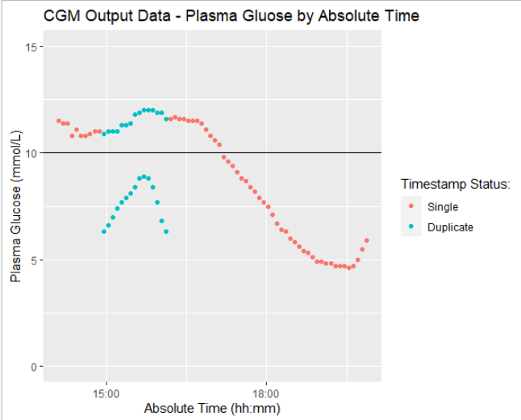
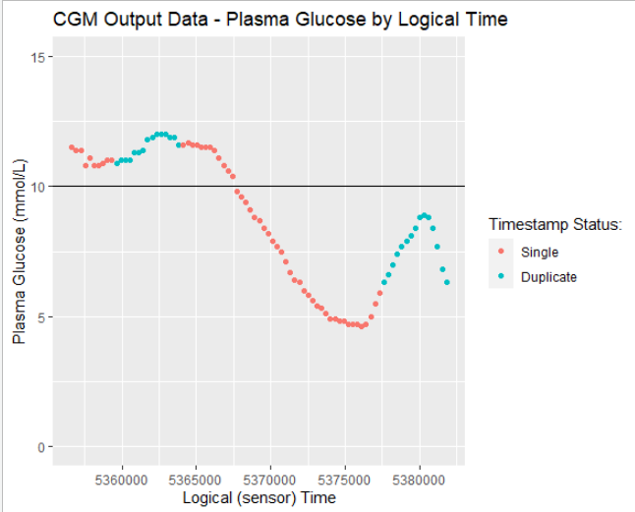
Duplicate Records in Clinical Trials
Presence of different results on the same assessment timepoint exist in wearables if contextual relationship between logical time (sensor) and absolute time (gateway) is disturbed:
Network connectivity complications.
Low-accuracy or misconfiguration of clocks used to establish absolute time.
Tampering by the user.

Slide 6
Duplicate Records in Clinical Trials
FDA asks to remove duplicate records in submission data:
Duplicate records should always be handled on the Data Management level whenever possible.
Not always feasible when duplicate data is sourced from a wearable system.
Currently, absolute time is used as key identifier for analysis:
There is no widely accepted analysis standard for when duplicate records are observed in absolute time.
We propose a robust analysis convention for duplicate records that occur on absolute timepoints, for functional data

Slide 7
Methodology
5 Step Methodology:
Identify duplicate timestamps
Set parameters:
Smoothing Function
Weights analysis value with expectations rooted data trends.
Clinical Trend Window
Defined by Disease State.
Calculate predicted value
Identify analysis value
Criterion Function
Preserves actuality of data observations.
Integrate single analysis value into final dataset

Slide 8
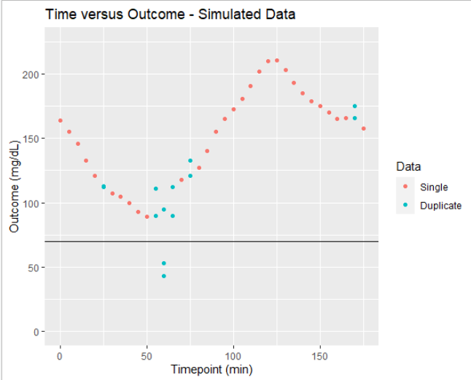
Step 1: Identify Duplicate Timestamps
To introduce this method we will use simulated time series data.
Duplicate timestamps were randomly generated and identified at:
T = 25, 55, 60, 65, 75, and 170 min.

Slide 9
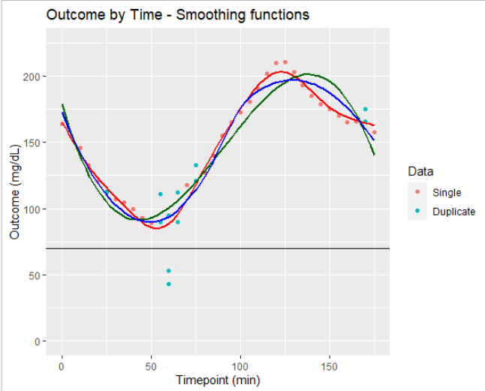
Step 2: Set Parameters (considerations)
Two Key Parameters:
Smoothing Function:
Statistical Method used to generate a continuous set of outcome estimates at a given timestamp.
Assume nonlinear data trends utilize flexible functions.
Clinical Trend Window:
Analysis window utilized by smoothing function to calculate predicted value.
Determined based on time needed to establish a clinical meaningful trend.
Dependent on disease state being analyzed.

Slide 10
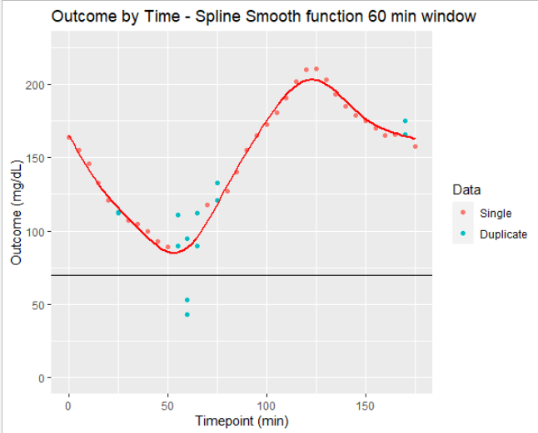
Step 2: Set Parameters (simulation example)
For this example:
Smoothing Function:
Generalized Additive Model (GAM) with a cubic spline as smoothing parameter.
Clinical Trend Window:
60 minutes.

Slide 11
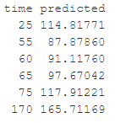
Step 3: Calculate Predicted Value
Calculate predicted value at each duplicate timepoint using Smoothing Function and Clinical Trend Widow parameters

Slide 12
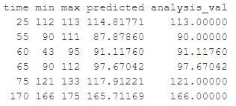
Step 4: Identify Analysis Value (criterion function)
Criterion function determines the appropriate value to be used for analysis (analysis value)
Preserves actuality of data observations
Never yield analysis value outside the range of observed observations.
Three values required
Predicted Value (y_pred):
Value predicted by smoothing function in step 3.
Minimum Value (y_min):
Smallest observed value at the duplicate timepoint.
Maximum Value (y_max):
Largest observed value at the duplicate timepoint.
Criterion Function
If y_pred ≥ y_min and y_pred ≤ y_max then analysis value = y_pred
Else if y_pred > y_max then analysis value = y_max
Else if y_pred < y_min then analysis value = y_min

Slide 13
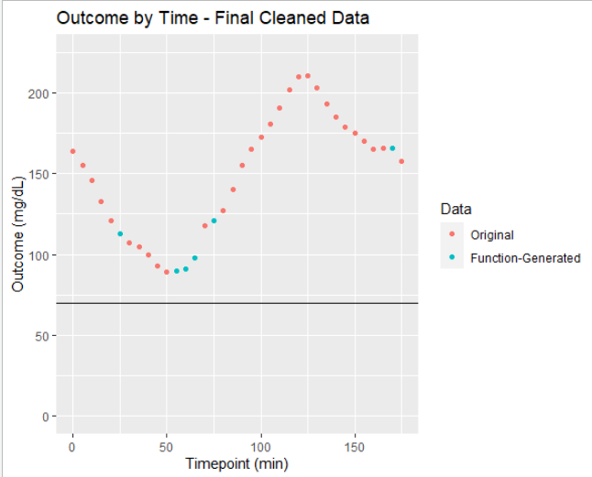
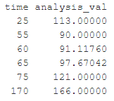
Step 5: Integrate Final Analysis
Each duplicate timepoint is assigned a singular outcome:
Set to output of the criterion function.
All other duplicate values are removed from the analysis dataset

Slide 14
Case Example:
A recent study used CGM to understand Hypoglycemia and Hyperglycemia associated with multiple drug therapies
Mismatch between logical and absolute time leading to duplication of CGM values over a 5 hour time range

Slide 15
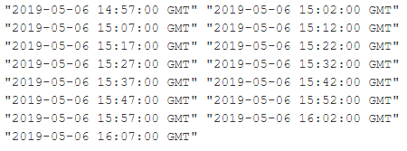
Case Example: Identify Duplicate Values
15 Duplicate Timestamps identified between 14:57 and 16:07

Slide 16
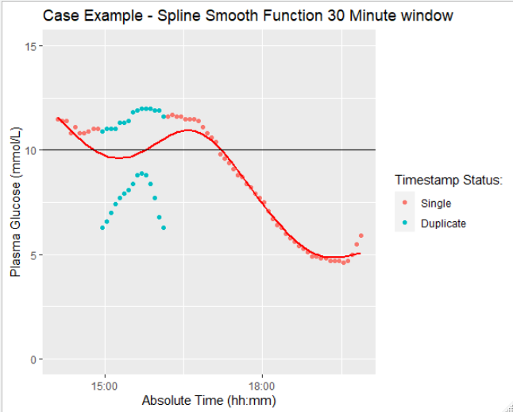
Case Example: Set Parameters
Smoothing Function:
Generalized Additive Model (GAM) with a cubic spline as smoothing parameter.
Clinical Trend Window:
30 minutes.
Window reflects literature of glucose control (disease state).

Slide 17
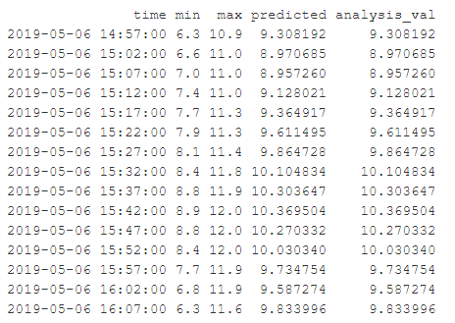
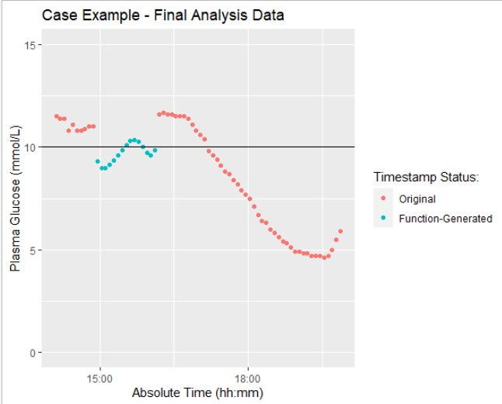
Case Example: Execute Function
All predicted values are contained within our observed values and will be used for analysis
5 analysis values are indicative of hyperglycemia (PG > 10 mmol/L)

Slide 18
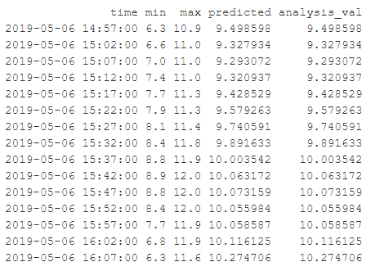
Clinical Considerations:
Changing the Clinical Trend Window yields different results
Statisticians and Clinicians must collaborate to optimize this parameter for different disease states and disease severity (e.g., high glucose variability).
Clinical Trend Window = 30 Min
Clinical Trend Window = 60 Min

Slide 19
Conclusion:
Wearables are growing in importance in clinical trials:
COVID-19 has forced an even greater reliance on remote monitoring and wearable data collection.
Duplicate timestamps may arise if relation between absolute and logical time are disrupted
Analysis conventions are needed when data management actions are not capable removing duplicate records prior to lock and analysis
Novel method introduces theoretically sound way to handle duplicate data from wearable devices
Practical application shown using CGM data from a diabetes management study:
Applications extend beyond the field of diabetes.
Can be applied to functional data in any clinical trial.

Slide 20
References:
M. Siddiqi, V. Sivaraman and S. Jha, "Timestamp integrity in wearable healthcare devices," 2016 IEEE International Conference on Advanced Networks and Telecommunications Systems (ANTS), Bangalore, 2016, pp. 1-6. doi: 10.1109/ANTS.2016.794778
Sirichenko, S., Kanevsky, M., (2016). Duplicate records – it may be a good time to contact your data management team. Paper present at PharmaSUG 2016 Conference Proceedings Techniques and Tutorials 18. Available at: https://www.pharmasug.org/proceedings/2016/TT/PharmaSUG-2016-TT18.pdf
Weenk M, Bredie SJ, Koeneman M, Hesselink G, van Goor H, van de Belt TH., Continuous Monitoring of Vital Signs in the General Ward Using Wearable Devices: Randomized Controlled Trial; J Med Internet Res 2020;22(6):e15471 URL: https://www.jmir.org/2020/6/e15471 DOI: 10.2196/15471 PMCID: 7315364
FDA Guidance on Conduct of Clinical Trials of Medical Products during COVD-19 Public Health Emergency
Fortunato, Michael et al. “Usability of Wearable Devices to Remotely Monitor Sleep Patterns Among Patients With Ischemic Heart Disease: Observational Study.” JMIR formative research vol. 4,4 e14508. 7 Apr. 2020, doi:10.2196/14508
Chico A, Vidal-Rios P, Subira M, Novials A: The continuous glucose monitoring system is useful for detecting unrecognized hypoglycemia in patients with type 1 and type 2 diabetes but is not better than frequent capillary glucose measurements for improving metabolic control. Diabetes Care 2003;26:1153–1157.
Petrie JR, Peters AL, Bergenstal RM, et al.: Improving the clinical value and utility of CGM systems: issues and recommendations: a joint statement of the European Association for the Study of Diabetes and the American Diabetes Association diabetes technology working group. Diabetes Care 2017;40:1614–1621.
Gay, Valerie, and Peter Leijdekkers. “Bringing Health and Fitness Data Together for Connected Health Care: Mobile Apps as Enablers of Interoperability.” Journal of medical Internet research vol. 17,11 e260. 18 Nov. 2015, doi:10.2196/jmir.5094
Finfer, Simon et al. “Clinical review: Consensus recommendations on measurement of blood glucose and reporting glycemic control in critically ill adults.” Critical care (London, England) vol. 17,3 229. 14 Jun. 2013, doi:10.1186/cc12537

Slide 21
Authors:
Jimmy G. Moore, M.S. – Biostatistician; Xeris Pharmaceuticals
Email: jmoore@xerispharma.com

